Slide 1
Social media and nonprofits
Session 1
Jim Miller, Ph.D.
Department of Communication
Harding University
Notes:
My adoption and connection to CFS
My work with colleagues and students helping organizations with social media strategies

Slide 2
Session 1 — Understanding the landscape
Session 2 — Current trends
Session 3 — Constructing a plan

Slide 3
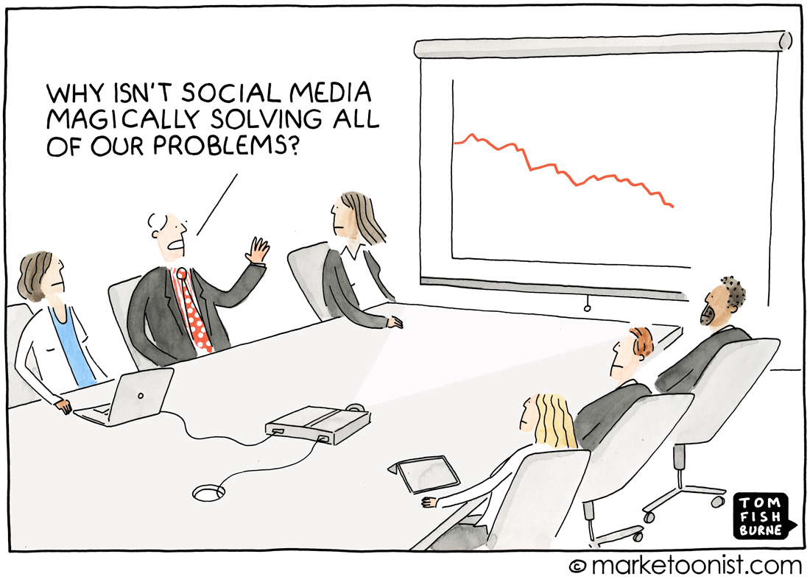
Notes:
https://marketoonist.com/

Slide 4
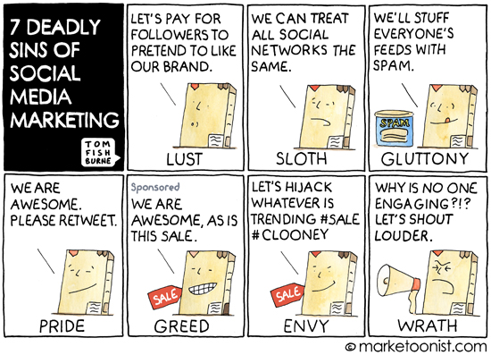
Notes:
https://www.marketingweek.com/2014/10/01/7-deadly-sins-of-social-media-marketing/

Slide 5
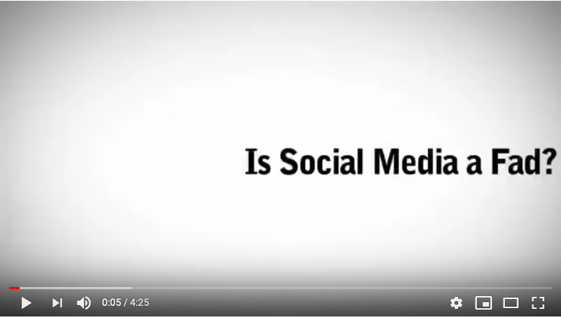
Notes:
https://www.youtube.com/watch?v=2uvx7c1E61Y

Slide 6
Digital media have revolutionized how we connect with our audiences.
Nonprofits have an advantage.
  Your purpose is more than selling a product.
  Your story is meaningful.
Most nonprofits struggle with using social media effectively.
  79% of nonprofits report using social media marketing.
  Only 24% of those think their approach is effective.
Three purposes of this first session
  Identify benefits
  Identify challenges
  Identify solutions
Notes:
Stats from CMI, 2016, https://contentmarketinginstitute.com/2017/06/nonprofit-marketing-2017/

Slide 7
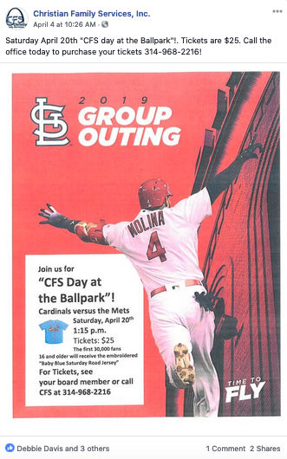
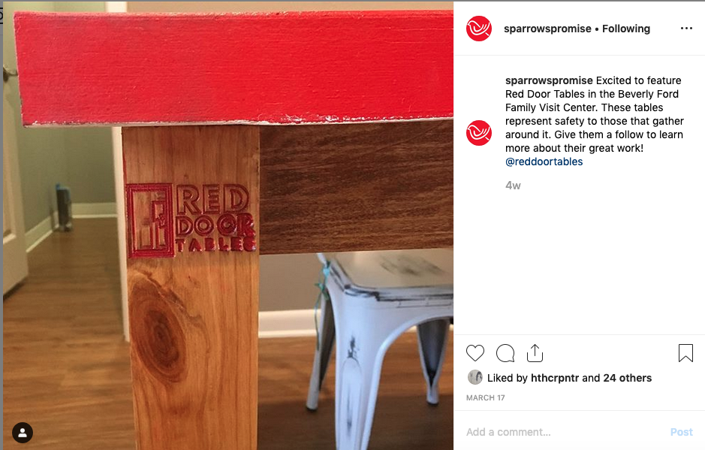
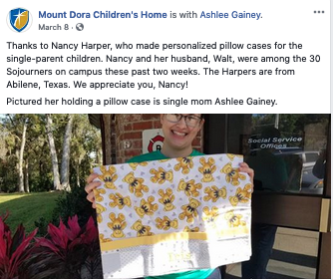
Benefits
Raise awareness
Raise volunteers
Raise funds
Notes:
Screen shots taken from family advocacy and agency social media sites

Slide 8
The challenges
Making time
Considering cost
Knowing which platforms to use
Knowing how much to post
Knowing what to post
Growing your audience
Others?

Slide 9






Making time
Digital tools to save time
  Hootsuite, Buffer
  Canva, Unsplash, Animoto
  Google Trends
  Native analytics (Facebook, Twitter, Instagram)
Divide time weekly among three activities
  Creating content
  Engaging with others
  Research and diving into analytics

Slide 10
Considering cost
5%-15% of your annual budget should be dedicated to marketing, according to U.S. Small Business Administration.
At least 50% of that budget should go to digital marketing.
  Paying for services and personnel
  Traditional marketing is not dead.
Notes:
https://prosper-strategies.com/nonprofit-marketing-budget-part-one/

Slide 11




Knowing which platforms to use
2.3 billion users
1.9 billion users
1 billion users
321 million users
51% of 13-17 year olds
81% of 18-29 year olds
78% of 30-49 year olds
65% of 50-64 year olds
41% of 65+ year olds
96%of 18-24 year olds
50% of 75+ year olds
72% of 13-17 year olds
64% of 18-29 year olds
40% of 30-49 year olds
21% of 50-64 year olds
10% of 65+ year olds
32% of 13-17 year olds
40% of 18-29 year olds
27% of 30-49 year olds
19% of 50-64 year olds
8% of 65+ year olds
Notes:
Choose two that reach your desired audience.
Mixed messages is a problem.
https://blog.hootsuite.com/youtube-stats-marketers/
https://sproutsocial.com/insights/new-social-media-demographics/#Twitter

Slide 12
Knowing how much to post
Every day per platform.
Best times to post to Facebook
  Thursdays, Fridays, Saturdays and Sundays at 9 a.m., 1 p.m., and 3 p.m. are best for reach and engagement.
  Saturdays and Sundays for highest engagement.
  Posting at 3 p.m. will get most clicks.
  Posting at 1 p.m. will get the most shares.
Best times to post to Instagram
  Mondays and Thursdays between 8 and 9 a.m.
Best times to post to Twitter
  Wednesdays at noon, 3 p.m., 5 p.m. and 6 p.m.
Notes:
https://mediacause.org/social-media-best-practices-for-nonprofits/

Slide 13
Knowing what to post
Show people how you help
Try recurring themes
Share news updates
Say thanks
Promote events
Current trends in nonprofit social media
Notes:
https://articles.bplans.com/a-nonprofits-ultimate-guide-to-social-media-marketing/

Slide 14
Growing your audience
Share content from other nonprofits
Tag others
Put social media buttons in emails
Hashtags
Notes:
https://articles.bplans.com/a-nonprofits-ultimate-guide-to-social-media-marketing/

Slide 15
Conclusion
Every nonprofit needs a digital media plan.
  Sessions #2 and #3
Questions and discussion
  What social media strategies have worked for you?
  What challenges have you had?

Slide 17
Nonprofit social media trends
Session 2
Jim Miller, Ph.D.
Department of Communication
Harding University

Slide 18
What social media trends do you see in your field?

Slide 19
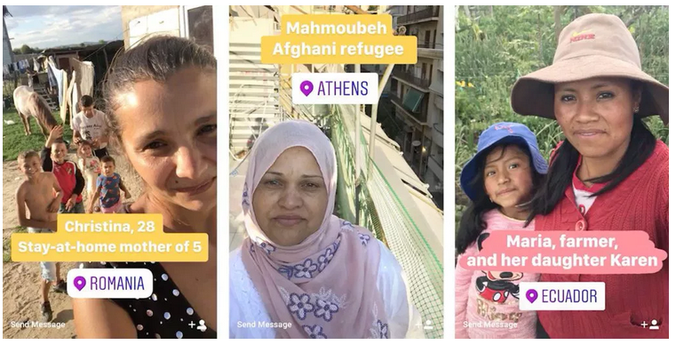
Stories
Notes:
CARE’s “Stories from the Other Side of the World”
Stories of seven women over seven days living daily life
https://donorbox.org/nonprofit-blog/7-nonprofit-social-media-trends-taking-over-2018/

Slide 20
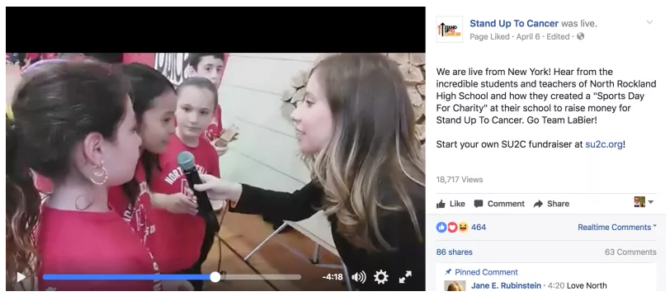
Live streams
Notes:
Live interviews
Events
Live bacsktage
Live Q and A
Live newsjacking and commentary
Example shown: https://www.nonprofitmarketingguide.com/blog/2019/02/13/use-facebook-live-to-raise-money-for-your-nonprofit/

Slide 21
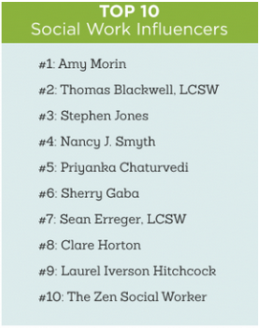

Influencers
Notes:
Searcy and Duck Dynasty
Top 10 Social Work Influencers: https://www.gradschools.com/programs/social-work/top-social-work-podcasts-and-influencers

Slide 22
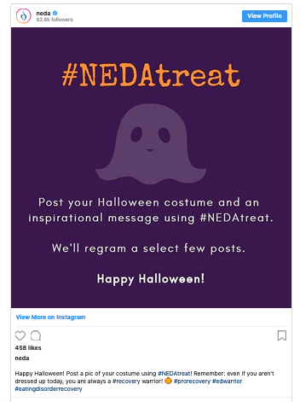
User-generated content
User-generated content
Notes:
Contests
Example from NEDA Instagram account

Slide 23
#Hashtags
#childwelfare #fostercare #children #socialworker #parents #adoption #socialworkers #socialwork #socialworkmonth #mentalhealth #family #kids #education #love #nonprofit #change #peacemaker #peace #changetheworld #giveback #familylaw #transformation #hiring #career #adopt
#newbeginnings #stopchildabuse #motivation #teens #dad #mom #childtrauma #parenting #socialworkerlife #awareness #childrenscharity #charity #blueribbon #childabuseandneglect #runagainstchildabuse #fosterparents #follow #kinshipcare #ascikinship #ourstaff #greatstaff #saveachild #theirvoices #voices #rewards #staffappreciation #appreciation
Notes:
Hash tags taken from: http://best-hashtags.com/hashtag/childwelfare/

Slide 25
Creating a social media strategy
Session 3
Jim Miller, Ph.D.
Department of Communication
Harding University

Slide 26
Create a social media strategy in 6 steps
Identify
Audit and research
Establish goals
Create engaging content
Build a calendar
Analyze and modify

Slide 27
Identify
Purpose statement: Why are you using social media? How will social media help accomplish the organization’s mission?
Audience: Who are you trying to reach and why? (Age, gender, geographic location, etc.)
Key messages: These key messages should be communicated in every digital post.

Slide 28
Audit and research
Take an inventory of what you are currently doing
  What social media accounts are you using?
  How often do you post?
  What types of content are you posting?
  Types of media are you using in you posts?
  How is your audience engaging your content (likes, reposts, comments, etc.)?
Research social media trends in your field
  What are others doing?
  How are their audiences engaging their content?

Slide 29
Establish goals
Identify at least three measurable goals for your digital media strategies.
  Examples: Increase shares, drive users to website, reach a fundraising goal, etc.
  These measurable goals will help you determine your ROI in social media.

Slide 30
Create engaging content
This is the fun part.
Remember the ideas we discussed earlier?
The digital tools we mentioned earlier can be used here.

Slide 31
Build a calendar
Compile a list of regular content ideas that could be implemented on a weekly basis.
Create a monthly calendar that includes a detailed weekly schedule.
Share ideas.

Slide 32
Analyze and modify
Assess your success with metrics and analytics.
Modify as needed to meet your goals.

Slide 33
Thank you!
Questions and discussion
Contact me: jemiller@harding.edu

