Slide 1
How Fostering Impacts Existing Children
Steve Duer, LICSW
Executive Director, Agape of Central Alabama

Slide 2
What happens to one impacts all

Slide 3
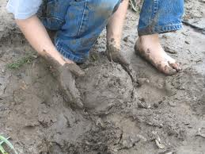
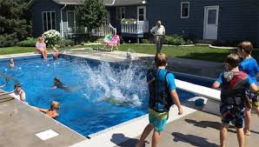
Characteristics of Successful Foster Families

Slide 4
What do we know about the impact…
Factor in disruption
Mixed attitudes about experience

Slide 5
Trouble Spots
Expectations
Sharing
Includes time & attention
Coming & Going
Role Confusion

Slide 6
So what do you do as a family?
Stability & Predictability
Be aware of your reactions
Let kids be kids

Slide 7
What can you do as an agency?
Take existing kids into account re: placements
Acknowledge existing kids
Include existing kids

Slide 8
Questions

